Slide 1
Notes
Marking Criteria
10% quality of work
5% quality of presentation
15 minutes total
10 minutes for demo/presentation
5 minutes for Q&A
Rest of time for supervisor and marker
Friday - 13:35-13:55
Congo

Slide 2
Applying Evolutionary Algorithms to Pokémon Team Building
Benjamin Charlton
psybc3@nottingham.ac.uk
4262648
Computer Science with Artificial Intelligence MSci

Slide 3
Motivation
Novelty of the idea
EAs simulate survival of the fittest
Pokémon is like a biological population
Based on real animals
Breeding
AI Game Playing moving to more complex games

Slide 4
AI Gameplaying - History
Symmetric games
Chess – Deep Blue
Go – AlphaGo
Dota 2 1v1– OpenAI
Strategy games
Many video games have built in AI
Limited in scope
Not always designed to be good
Pregame decisions made by game designers/experts

Slide 5
The Approach
Evolutionary algorithms
Genetic Algorithms
Memetic Algorithms
Designed and built from scratch
Custom Solution

Slide 6
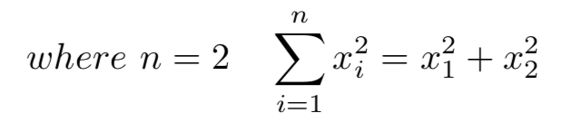

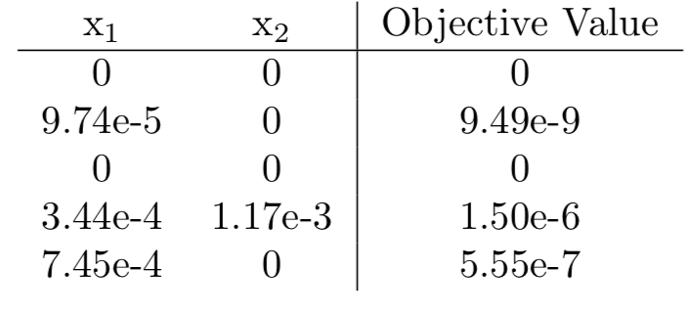
Demo
Running on a benchmark function
Sum of Squares
2 genes
Range -5, 5
Results from 5 runs
Proof that the EA works
Full problem has a long running time
48 hours+

Slide 7
Pokémon – The franchise
20+ year old franchise
31 main series games
~100 spin off titles
10s Millions of games sold
1000+ anime episodes
21 Movies
Countless tie in toys
Recognised worldwide

Slide 8
Pokémon – Core Gameplay
Main Games
Story based RPG
Up and coming Pokémon trainer
Battle your way to the top
8 Gym battles
4 Elite Four members
1 Champion
Taking down an evil gang too

Slide 9
Pokémon – Battles
Typically 2 players competing
Each player brings up to 6 Pokémon
Win by fainting all of your opponents Pokémon
Reducing their HP to 0
Turn based combat
1 Pokémon can fight at once
Select a move, use an item or switch to a different Pokémon
Damage Dealt differs

Slide 10
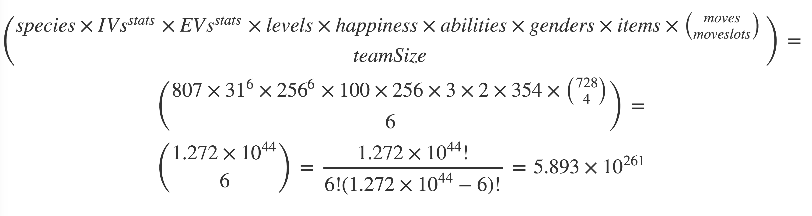
The Problem
Pokémon Team Building
Not all representations are valid
Create the best team for battling
Large search space

Slide 11
Representation
High level design
Validation of individuals
Printing to user
Heavily relies upon PokéAPI

Slide 12
Representation

Slide 13
Fitness Scoring
Objective Function – hard/impossible
Compare individuals to each other
Each team scored against all other teams
Each Pokémon in each team is scored against each Pokémon
Team V Team score is total of all team members
Individual score is the average of all Team V Team scores

Slide 14
EA Solution
Jirachi
Ability: Serene Grace
Level: 42
Shiny: Yes
Happiness: 196
EVs: 73 HP / 84 Atk / 95 Def / 80 SpA / 97 SpD / 81 Spe
Mild Nature
IVs: 19 HP / 0 Atk / 5 Def / 25 SpA / 20 SpD / 2 Spe
- Dazzling Gleam
- Psychic
- Charge Beam
- Round
Shuppet (M) @ Black Glasses
Ability: Insomnia
Level: 98
Happiness: 57
EVs: 80 HP / 87 Atk / 85 Def / 100 SpA / 72 SpD / 86 Spe
Lax Nature
IVs: 19 HP / 0 Atk / 4 SpA / 27 SpD / 11 Spe
- Headbutt
- Magic Room
- Phantom Force
- Thunderbolt
Panpour (M) @ fullrestore
Ability: Gluttony
Level: 78
Shiny: Yes
Happiness: 83
EVs: 91 HP / 81 Atk / 81 Def / 87 SpA / 83 SpD / 87 Spe
Hardy Nature
IVs: 25 Atk / 18 Def / 8 SpA / 21 SpD / 26 Spe
- Water Sport
- Brine
- Secret Power
- Fling
Dialga @ Meadow Plate
Ability: Pressure
Level: 57
Shiny: Yes
Happiness: 178
EVs: 91 HP / 89 Atk / 70 Def / 80 SpA / 93 SpD / 87 Spe
Sassy Nature
IVs: 26 HP / 4 Def / 17 SpA / 10 SpD / 14 Spe
- Rock Tomb
- Ice Beam
- Thunder
- Round
Emolga (M) @ xattack
Ability: Static
Level: 70
Shiny: Yes
Happiness: 80
EVs: 71 HP / 89 Atk / 84 Def / 89 SpA / 89 SpD / 88 Spe
Rash Nature
IVs: 26 HP / 12 Atk / 25 Def / 19 SpA / 25 SpD
- Signal Beam
- Discharge
- Hidden Power
- Taunt
Ribombee (M)
Ability: Shield Dust
Level: 52
Shiny: Yes
Happiness: 241
EVs: 108 HP / 80 Atk / 82 Def / 74 SpA / 91 SpD / 75 Spe
Calm Nature
IVs: 27 HP / 20 Atk / 10 Def / 17 SpA / 0 SpD / 0 Spe
- Acrobatics
- Bug Buzz
- Thief
- Substitute

Slide 15
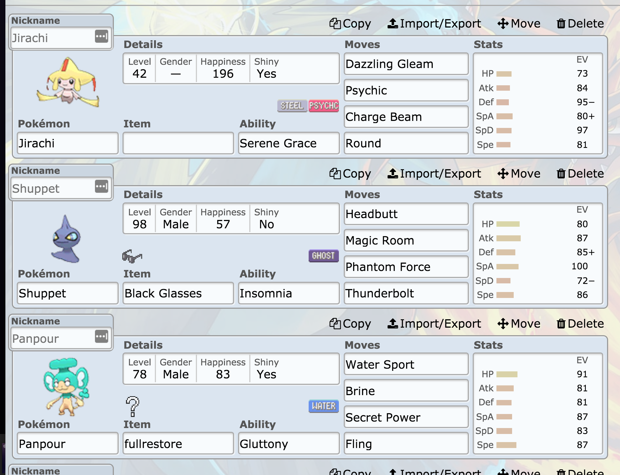
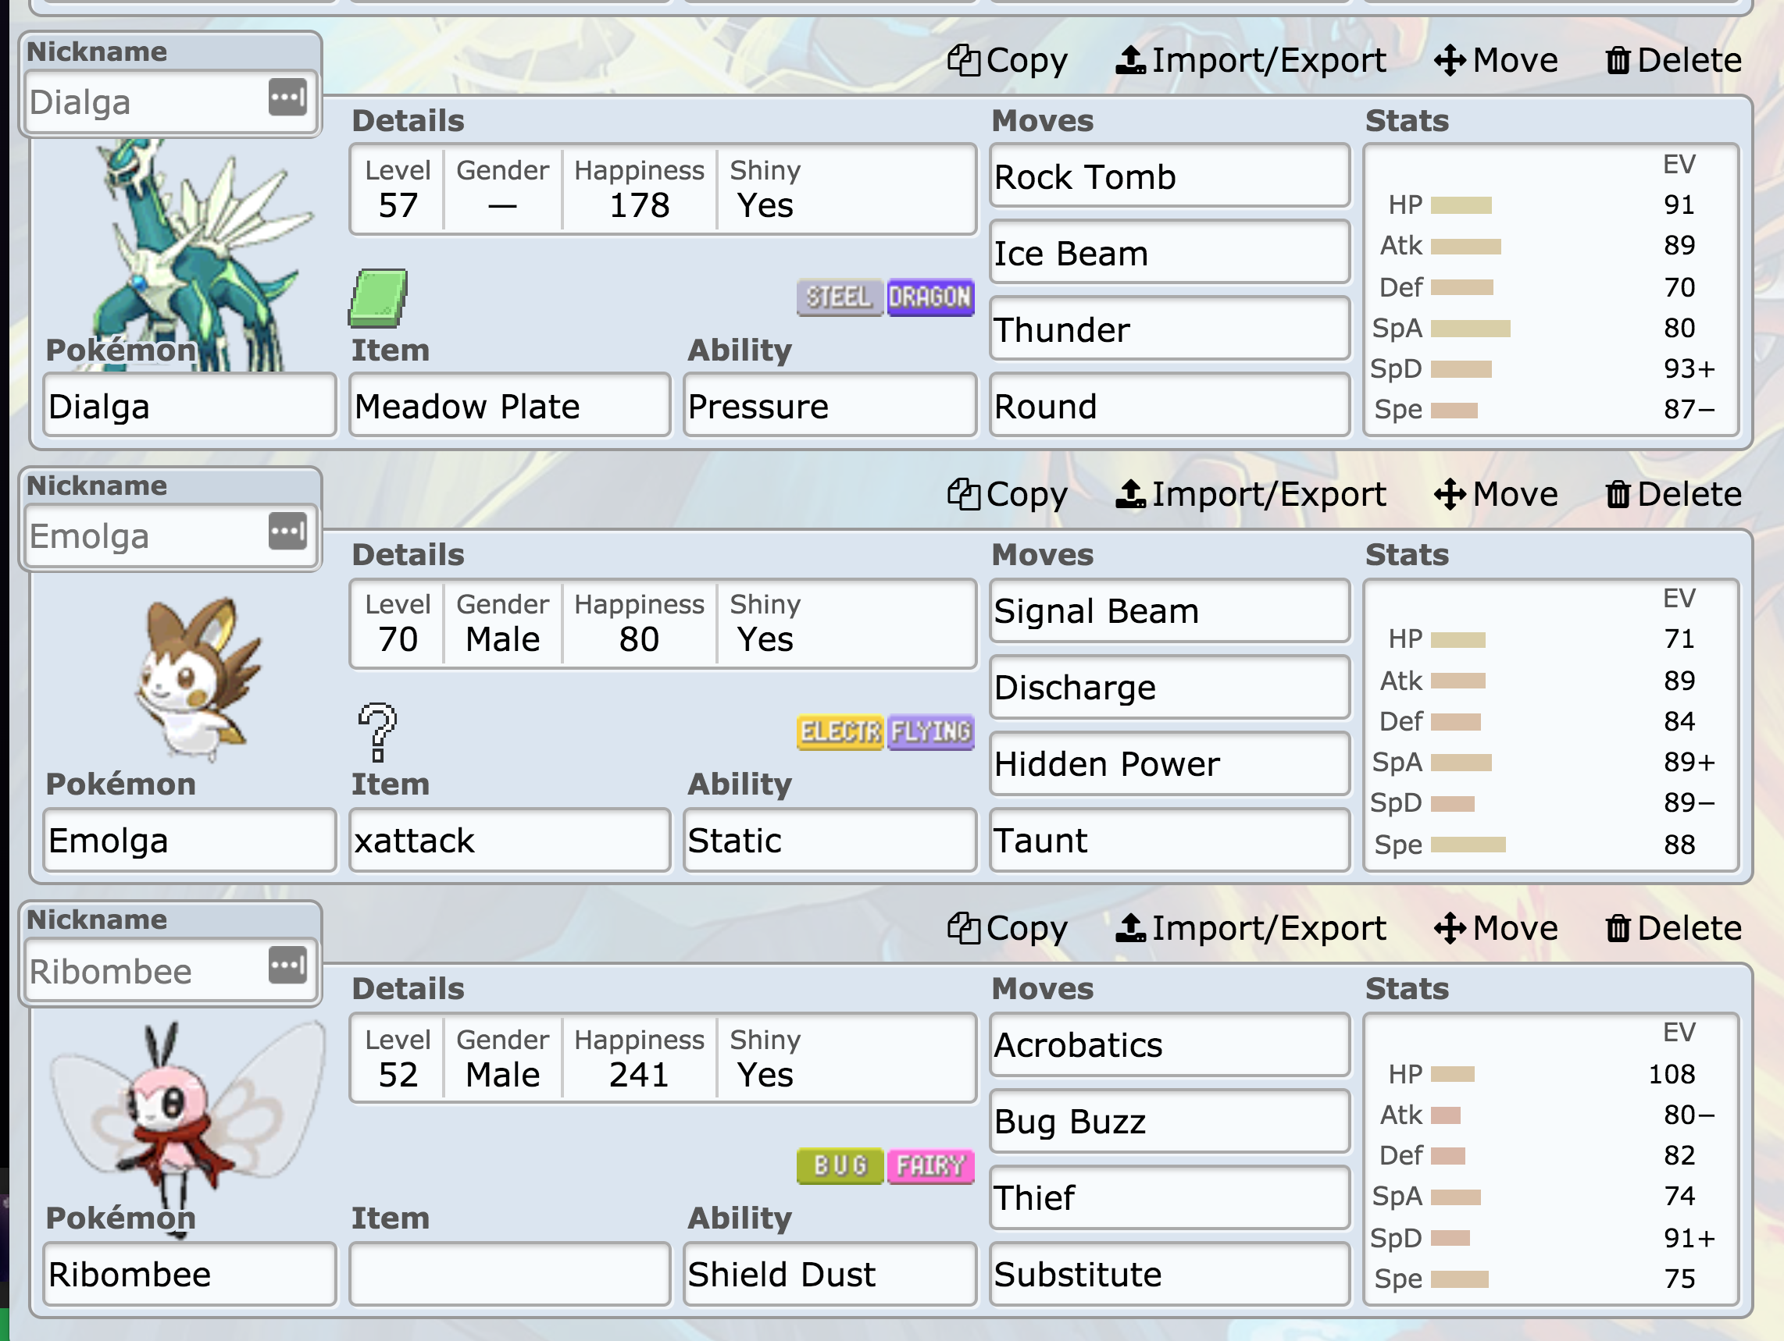
EA Solution

Slide 16
Further Considerations
Reducing the search space
Optimising single Pokémon ~10⁴¹
Restricting values to optimal values
Omitting values that are easily optimised
Parallelise to speed up run time
Use more accurate simulations
Better scoring
Research comparative fitness functions
Compare less individuals

Slide 17
Thank you
Q&A

